Slide 1
Chapter 2 – Requirements Engineering

Slide 2
Topics covered
Requirement Engineering
Crucial Process Steps of Requirement Engineering
Types of Requirements
User and System Requirements
Categories of Metrics
Software Requirements Specification (SRS) Document
Requirements Gathering Techniques

Slide 3
2.1 Requirements Engineering
The process of establishing the services that the customer requires from a system and the constraints under which it operates and is developed.
The requirements themselves are the descriptions of the system services and constraints that are generated during the requirements engineering process.
Requirements engineering is one of the most crucial activity in this creation process. Without well-written requirements specifications, developers do not know what to build, customers do not know what to expect, and there is no way to validate that the built system satisfies the requirements.

Slide 4
2.2 Crucial Process Steps of Requirement Engineering
The requirements engineering consists of four steps
The primary output of requirements engineering is requirements specifications. If it describes both hardware and software, it is a system requirements specifications. If it describes only software, it is a software requirements specifications.
Process Step | Description
Requirements elicitation | This is also known as gathering of requirements. Here requirements are identified with the help of customer and existing systems process if available.
Requirements analysis | The requirements are analyzed in order to identify inconsistencies, defects, omissions, and also resolve conflicts if any.
Requirements documentations | It is the foundation for the design of the software. The document is known as software requirements specification (SRS).
Requirements review | The review process is carried out to improve the quality of the SRS.

Slide 5
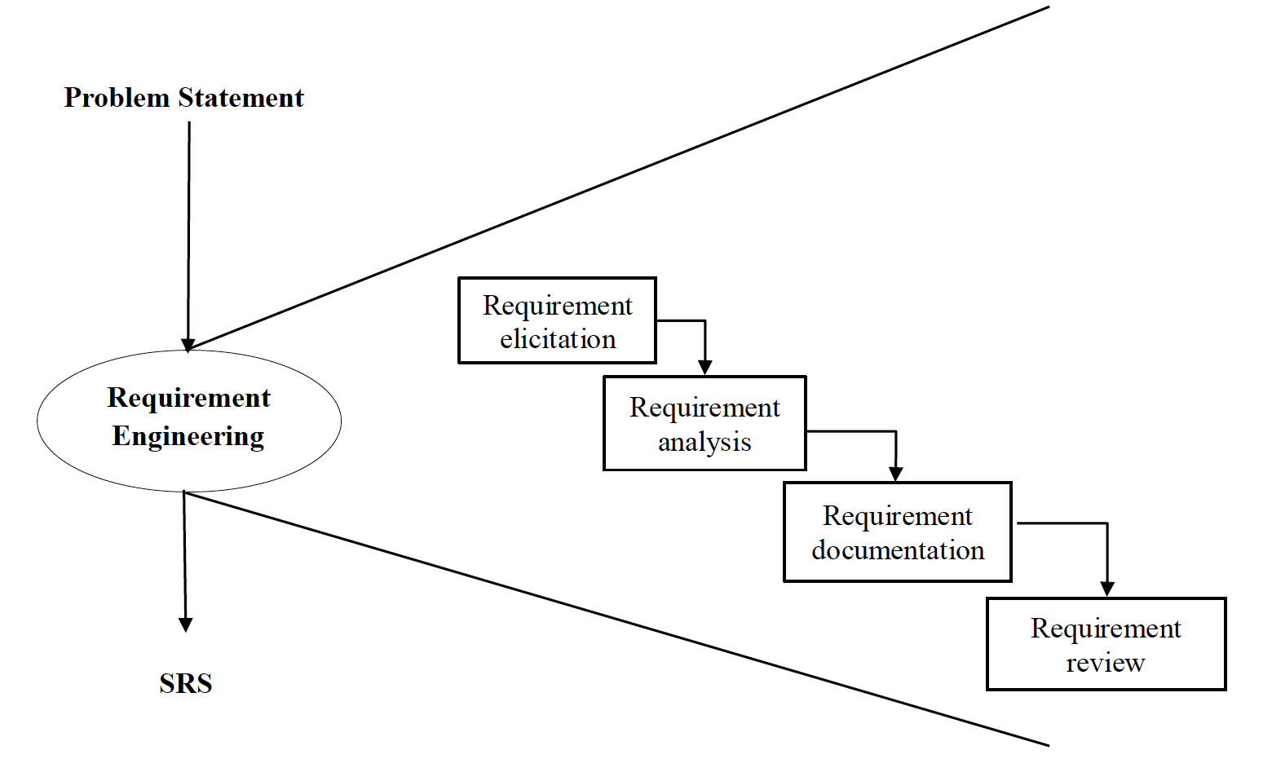
Crucial Process Steps of Requirement Engineering
Figure 2.1: Crucial Process Steps of Requirement Engineering

Slide 6
2.3 Types of Requirements
Functional requirements
Statements of services the system should provide, how the system should react to particular inputs and how the system should behave in particular situations.
May state what the system should not do.
Non-functional requirements
Constraints on the services or functions offered by the system such as timing constraints, constraints on the development process, standards, etc.
Often apply to the system as a whole rather than individual features or services.

Slide 7
Functional Requirements
Describe functionality or system services.
Depend on the type of software, expected users and the type of system where the software is used.
Functional user requirements may be high-level statements of what the system should do.
Functional system requirements should describe the system services in detail.

Slide 8
Non-Functional Requirements
These define system properties and constraints e.g. reliability, response time and storage requirements. Constraints are I/O device capability, system representations, etc.
Process requirements may also be specified mandating a particular IDE, programming language or development method.
Non-functional requirements may be more critical than functional requirements. If these are not met, the system may be useless.

Slide 9
Non-Functional Classifications
Figure 2.2: Types of Non-Functional Requirement

Slide 10
Non-Functional Classifications
Product requirements
Requirements which specify that the delivered product must behave in a particular way e.g. execution speed, reliability, etc.
Organisational requirements
Requirements which are a consequence of organisational policies and procedures e.g. process standards used, implementation requirements, etc.
External requirements
Requirements which arise from factors which are external to the system and its development process e.g. interoperability requirements, legislative requirements, etc.

Slide 11
2.4 User and System Requirements
User requirement are written for the users and include functional and non-functional requirement. User requirements should specify the external behavior of the system with some constraints and quality parameters.
System requirement are derived from user requirement. They are expanded form of user requirements.
A measure provides a quantitative indication of the extent, amount, dimension, capacity, or size of some attribute of the product or process”.
Measurement is the act of determine a measure.
The metric is a quantitative measure of the degree to which a system, component, or process possesses a given attribute.

Slide 12
2.5 Categories of Metrics
Product metrics: describe the characteristics of the product such as size, complexity, design features, performance, efficiency, reliability, portability, etc.
Property | Measure
Speed | Processed transactions/second User/event response time Screen refresh time
Size | Mbytes Number of ROM chips
Ease of use | Training time Number of help frames
Reliability | Mean time to failure Probability of unavailability Rate of failure occurrence Availability
Robustness | Time to restart after failure Percentage of events causing failure Probability of data corruption on failure
Portability | Percentage of target dependent statements Number of target systems

Slide 13
Categories of Metrics
Process metrics: describe the effectiveness and quality of the processes that produce the Software product. Examples are:
Effort required in the process
Time to produce the product
Effectiveness of defect removal during development
Number of defects found during testing
Maturity of the process
Project metrics: describe the project characteristics and execution. Examples are:
Number of software developers
Staffing pattern over the life cycle of the software
Cost and schedule
Productivity

Slide 14
2.6 Software Requirements Specification (SRS) Document
The SRS is a specification for a particular s/w product, program, or set of programs that performs certain functions in a specific environment.
The SRS serve as contract document between customer and developer. SRS reduces the probability of the customer being disappointed with the final product.
Nature of the SRS: The basic issues of that SRS writer(s) shall address the following:
Functionality
External interface
Performance
Attributes
Design constraints imposed on an implementation

Slide 15
Characteristics of a Good SRS
The SRS should be:
Correct
Unambiguous
Complete
Consistent
Rank for importance and/ stability
Verifiable
Modifiable
Traceable

Slide 16
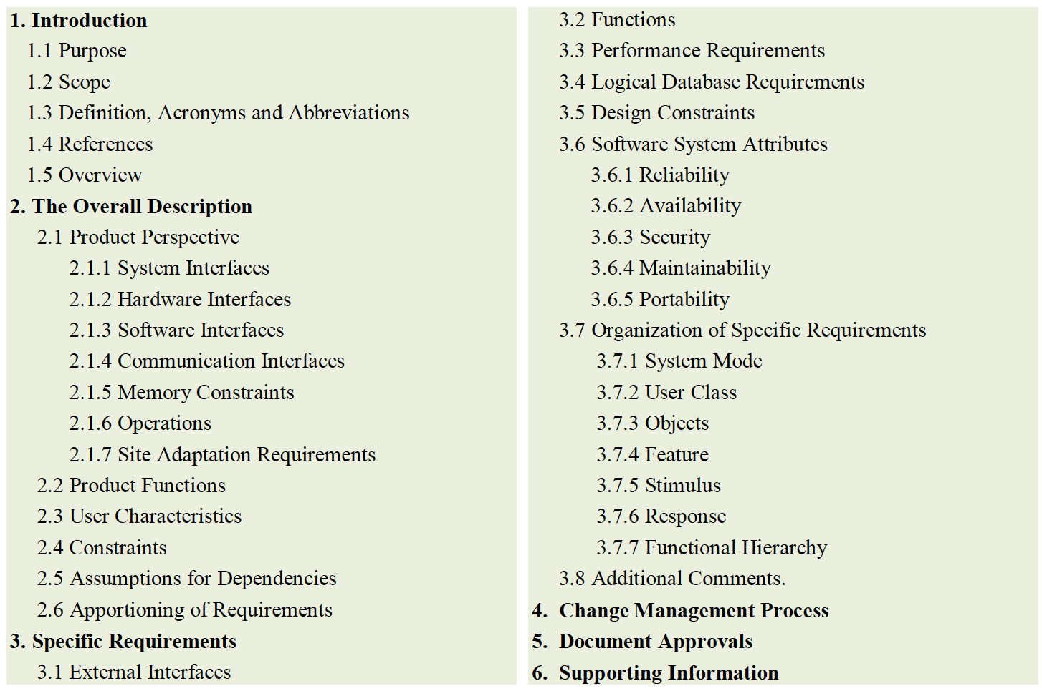
Organization of the SRS
The (IEEE) has published guidelines and standards to organize an SRS document.
Different projects may require their requirements to be organized differently but still first two sections of the SRS are the same in all of them.
The template to organize and draft the SRS for any project.

Slide 17
2.7 Requirements Gathering Techniques
Some requirements gathering techniques may be beneficial in one project but may not be in other.
The usefulness of a technique is determined by its need and the kind of advantages.
Following are some popular requirements gathering techniques:

Slide 18

Brainstorming
Description
Brainstorming is human nature to solve any problem as an early thought process. It can be utilized to gather a good number of ideas from a group of people by sharing ideas to identify all possible solutions.

Slide 19

Document Analysis
Description
Usually followed where a system is already in place, so evaluating the documentation of a present system can assist to gather requirements for updating or replacing existing system.

Slide 20

Focus Group
Description
A focus group is a gathering of people who are customers or user representatives for a product to gain its feedback. The feedback can be collected about opportunities, needs, and problems to determine requirements or it can be collected to refine and validate the already elicited requirements.

Slide 21
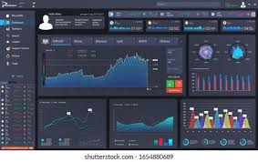
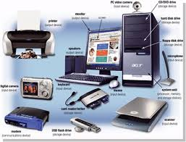
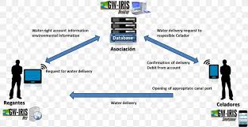
Interface Analysis
Description
Interface for any software product are either be human or machine. Integration with external devices and systems is another interface. The user-centric design approaches are quite effective to collect and develop usable software.

Slide 22

Interview
Description
Interviews of users and stakeholders are important in creating wonderful software. Without knowing the expectations and goal of the stakeholders and users it is impossible to satisfy them. To understand the perspective of every interviewee it is important to properly collect their inputs. Like a good reporter, listening is a quality that assists an excellent analyst to gain better value through an interview.

Slide 23
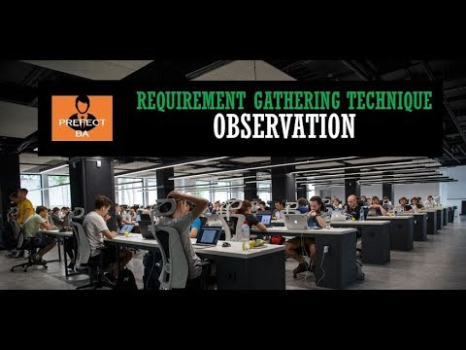
Observation
Description
The observation covers the study of users in their workplace. By watching users, a process flow, pain points, awkward steps and opportunities can be determined by an analyst for improvement. Observation can either be passive or active. Passive observation provides better feedback to refine requirements on the same hand active observation works best for obtaining an understanding over an existing business process.

Slide 24
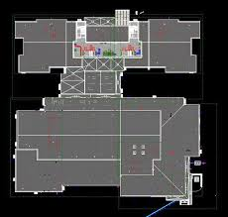
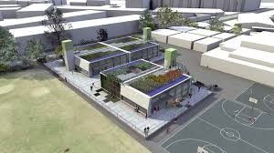

Prototyping
Description
Prototyping can be very helpful at gathering feedback. Low fidelity prototypes make a good listening tool. Many a times, people are not able to articulate a specific need in the abstract. They can swiftly review whether a design approach would satisfy their need. Prototypes are very effectively done with fast sketches of storyboards and interfaces.

Slide 25
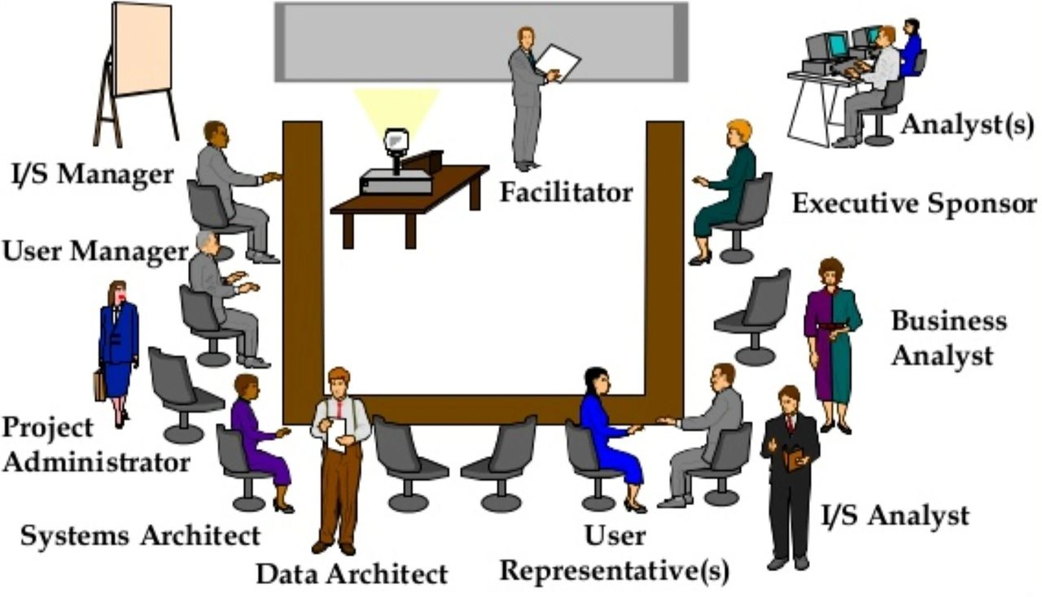
Requirements Workshop
Description
Popularly known as JAD or joint application design, these workshops can be efficient for gathering requirements. The requirements workshops are more organized and structured than a brainstorming session where the involved parties get together to document requirements.

Slide 26
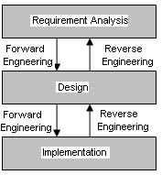
Reverse Engineering
Description
When a legacy project does not have enough documentation, reverse engineering can determine what system does? It do not determine what features went wrong with the system and what a system must do.

Slide 27

Survey
Description
When gathering information from many people: too many to interview with time constraints and less budget: a questionnaire survey can be used. The survey insists the users to choose from the given options agree / disagree or rate something.

Slide 28
Key points
Requirements for a software system set out what the system should do and define constraints on its operation and implementation.
Functional requirements are statements of the services that the system must provide or are descriptions of how some computations must be carried out.
Non-functional requirements often constrain the system being developed and the development process being used.
They often relate to the emergent properties of the system and therefore apply to the system as a whole.

Slide 29
Review Questions
Define: requirements engineering, measure, measurement, metrics, SRS
Illustrate crucial process steps of requirement engineering with neat diagram
Differentiate Functional and Non-functional Requirements
Explain different classifications of Non-functional requirements
What are the different categories of metrics?
What are the basic issues addressed by SRS writers
List down the characteristics of good SRS
Explain various requirement gathering techniques.

